Slide 1
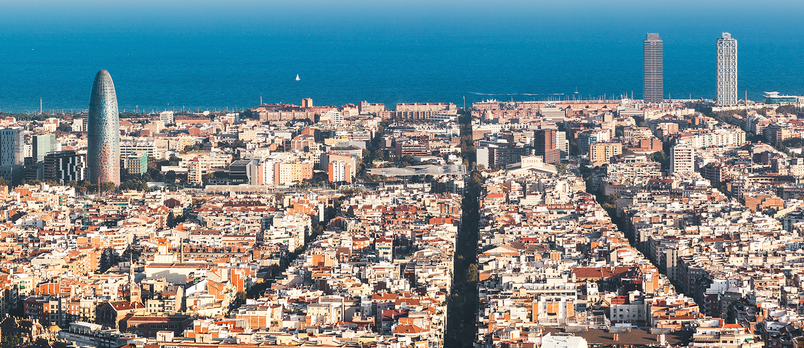

Inyección de dependencias en Spfx, sí, se puede!
Luis Mañez
#SPSBCN
September 14th 2019
Notes:
Template may be modified but please keep the title and the sponsor slide.
Twitter hashtag: #spsbcn for all sessions

Slide 2
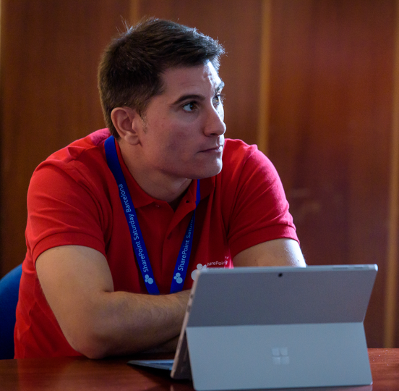




Luis Mañez
ClearPeople LTD - Cloud Architect
MS Office Development MVP. About 20 years of experience working with Microsoft Technologies. MS Certified specialist in Developing Azure and SharePoint MCPD. Passionate about technology, blogger, technical writer and MS community active member.
https://github.com/luismanez
@luismanez
www.linkedin.com/in/luismanez/

Slide 3
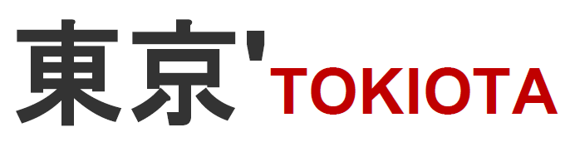

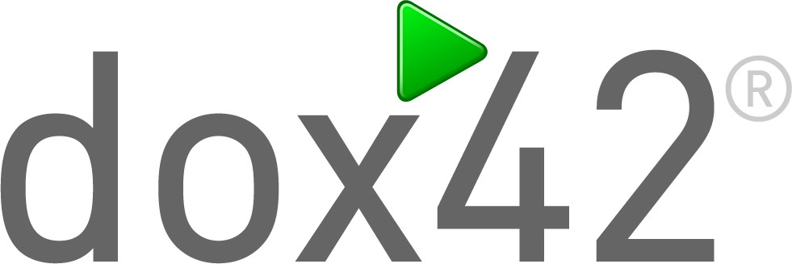







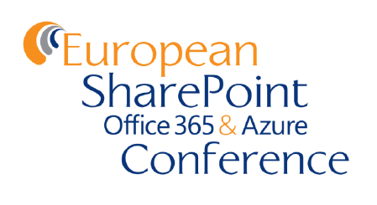



Platinum
Gold
Silver
Raffle
Organized by
Notes:
Use this as the first slide in your slide deck

Slide 4
Dependency Inversion Principle

Slide 5
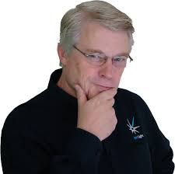
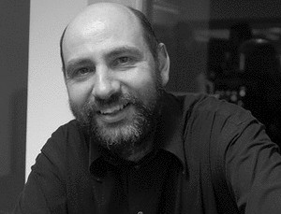
Entities must depend on abstractions not on concretions. It states that the high-level module must not depend on the low-level module, but they should depend on abstractions.
Rob C. Martin (AKA Uncle Bob)
Martin Fowler

Slide 6

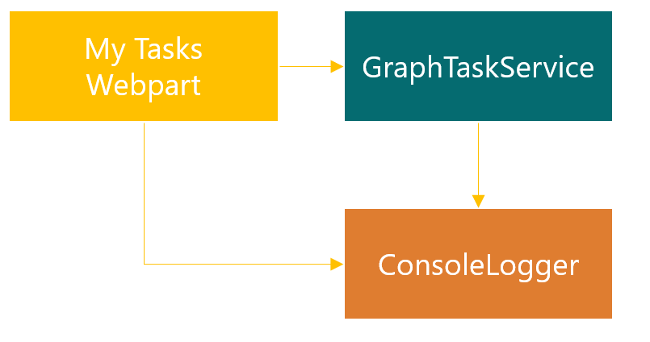

Slide 7

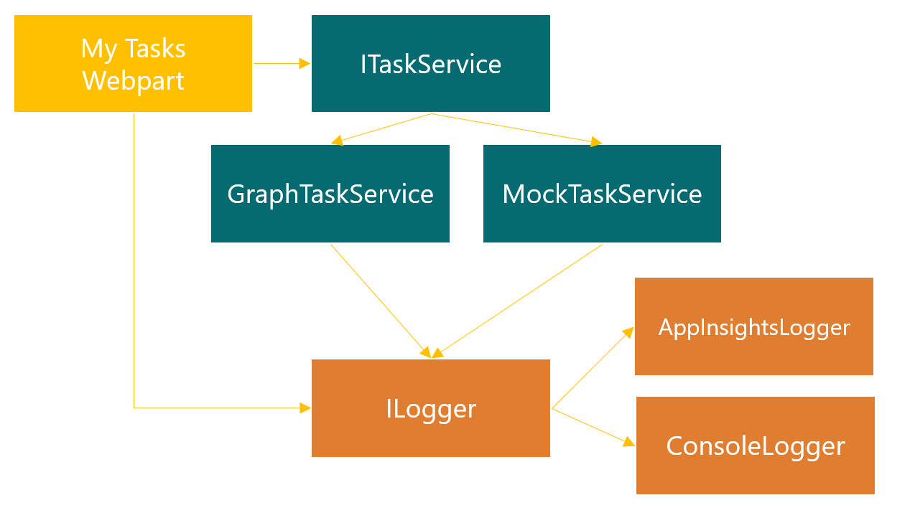

Slide 8
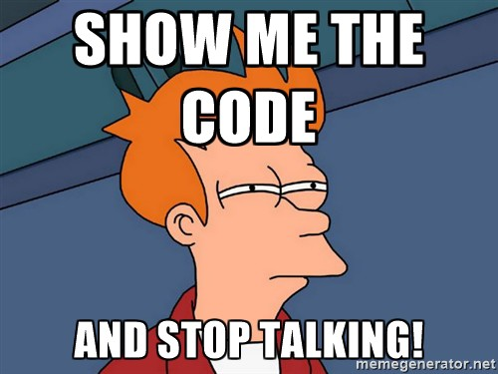

Slide 10
https://github.com/luismanez/sp-saturday-barcelona-2019

Slide 11

Thank you!
Questions?
#SPSBCN

